Slide 1
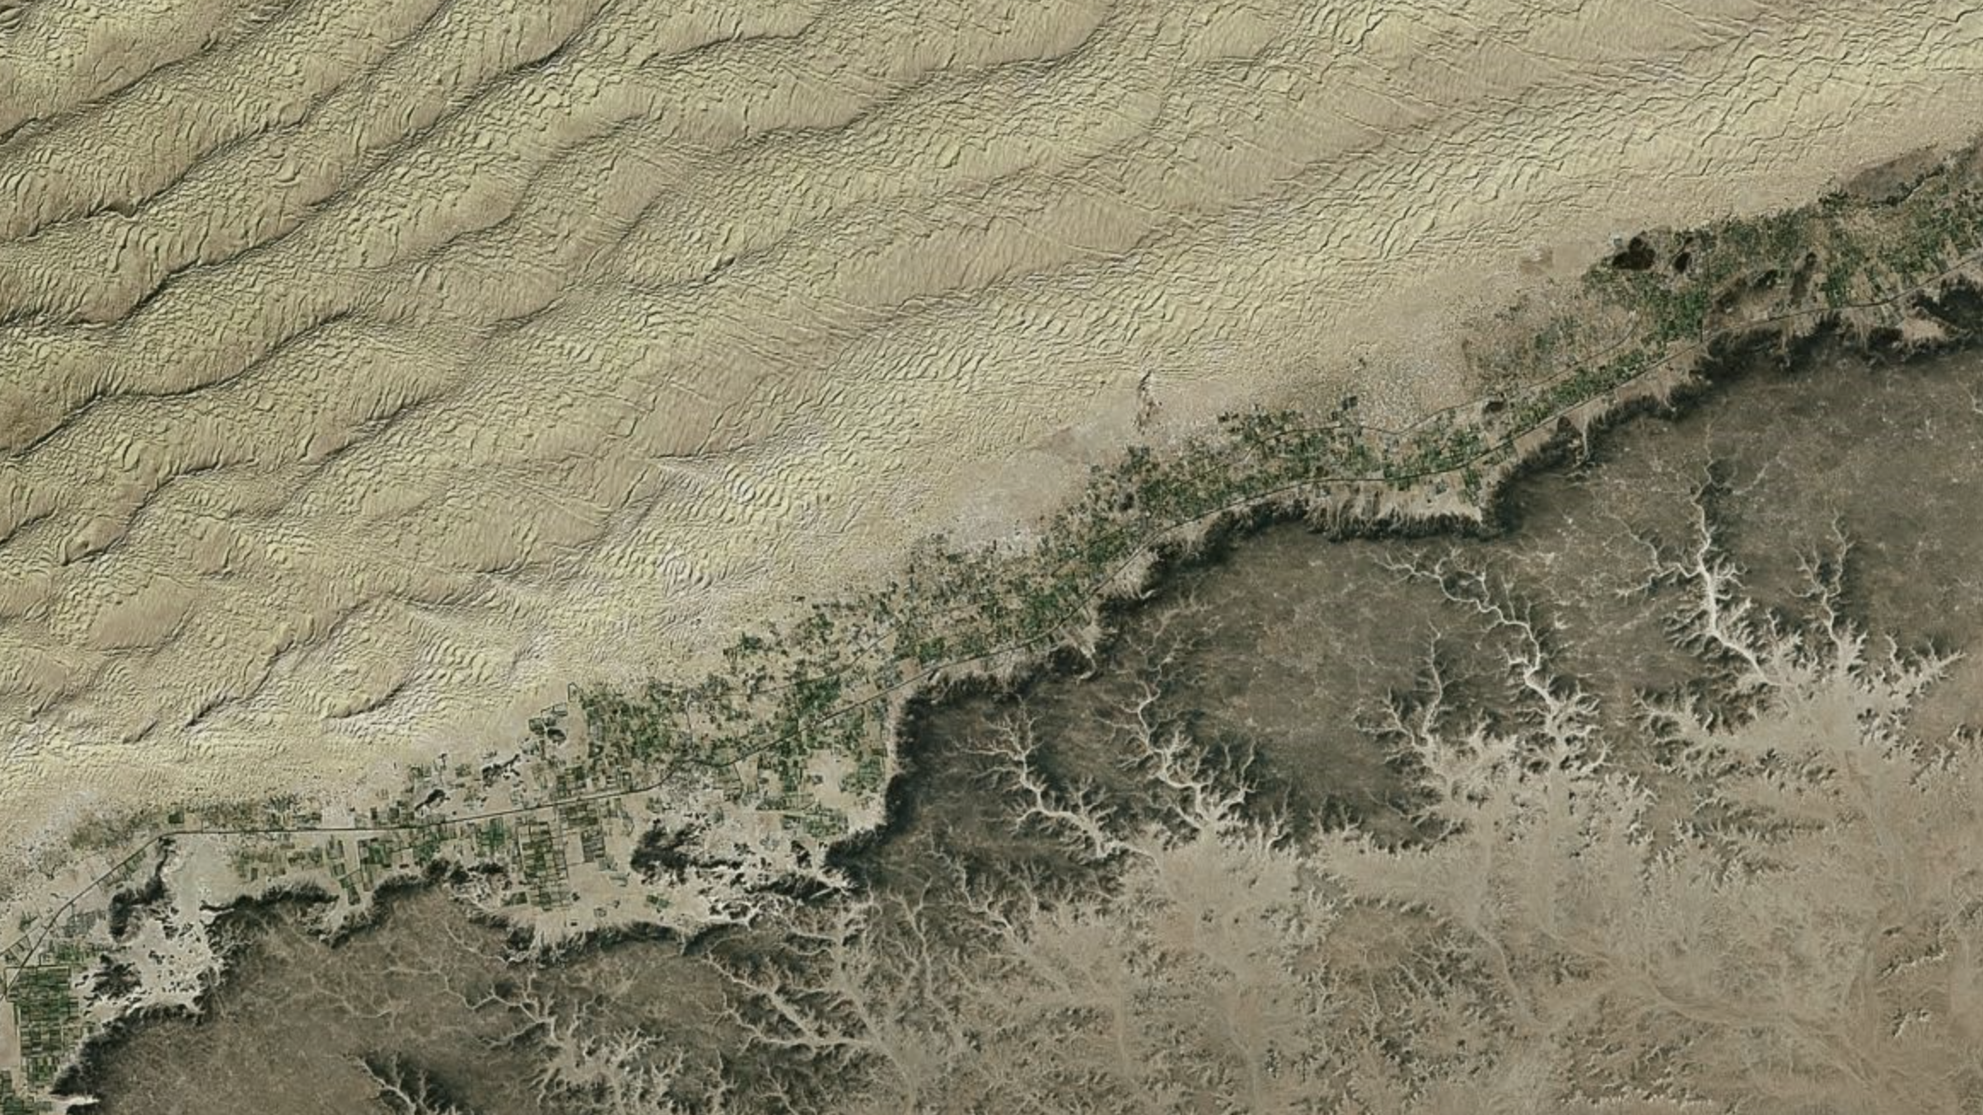
21st-Century stagnation in unvegetated sand-sea activity
Andrew Gunn¹, Amy East², Douglas Jerolmack³
¹Monash University
²United States Geological Survey
³University of Pennsylvania

Slide 2
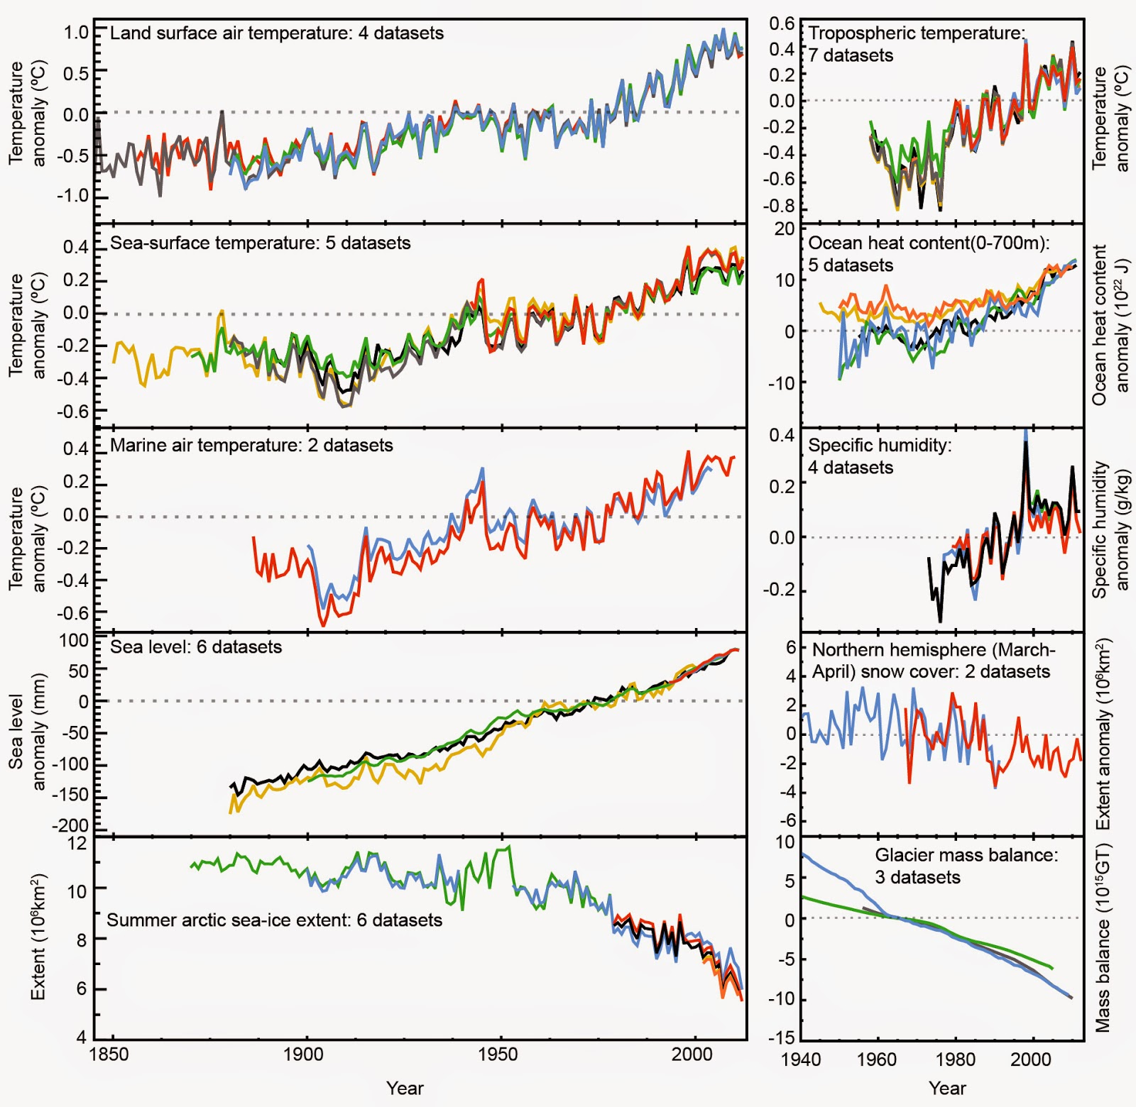
Motivation: Climate is changing
We see effects in many observables in the climate system
We predict large changes in this observables over this century
How is this affecting sand seas?
(IPCC AR5, 2013)

Slide 3
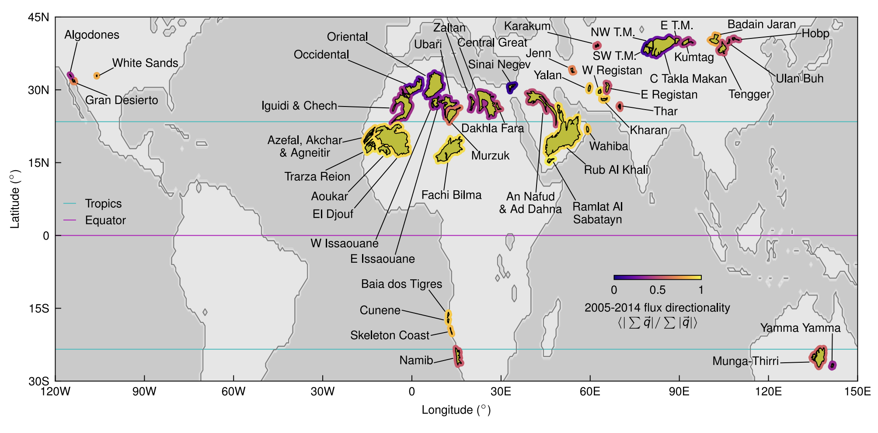
Aim: Assess all large active unvegetated sand seas

Slide 4
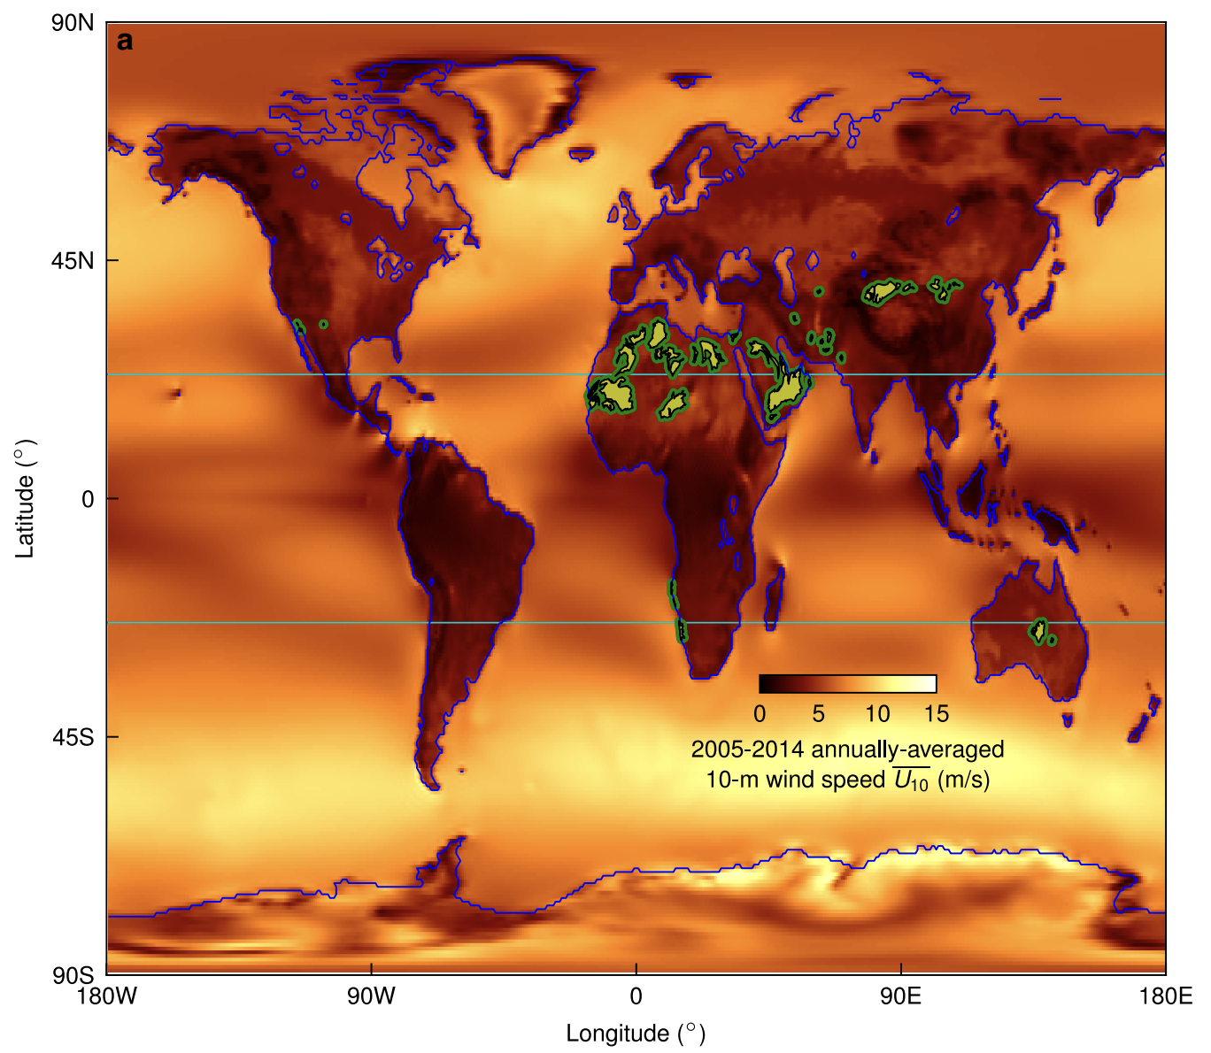
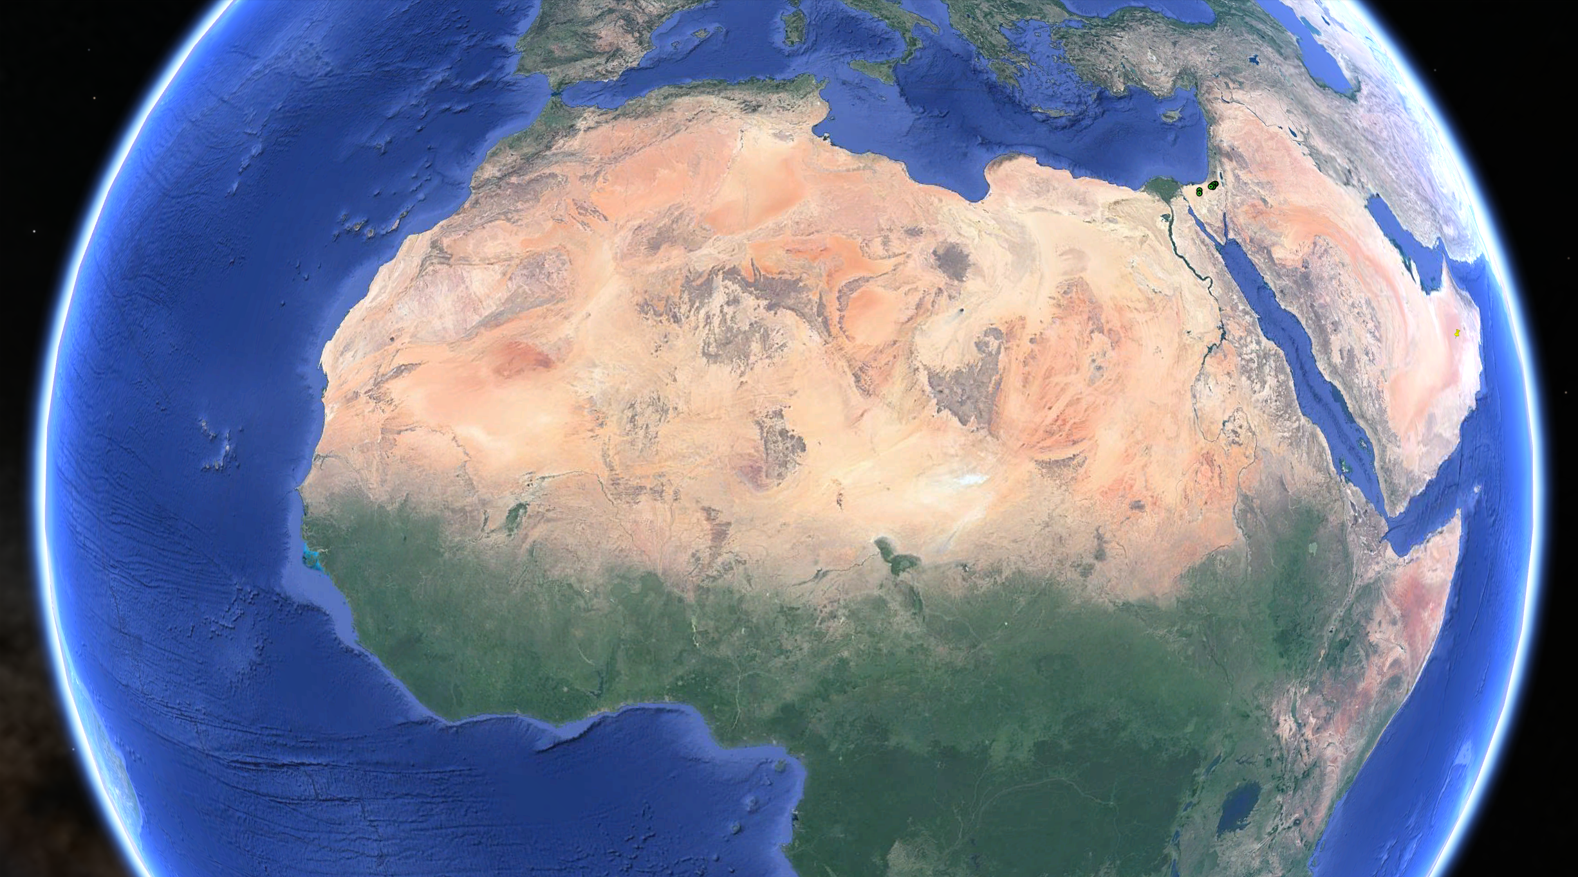
Background: Near-surface winds drive sand-sea activity
Conditions required for sand seas:
Climate is dry and windy
Source of sand

Slide 5
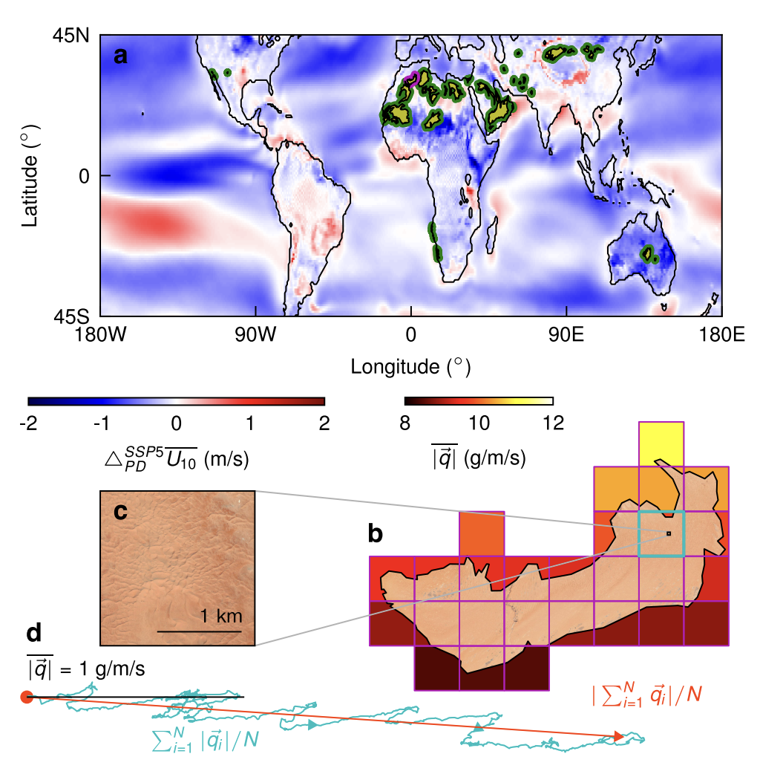
Methods: Measure sand-sea activity using sand flux
Sand flux goes like the square of wind speed in excess of a threshold
We look at changes in sand flux using a CMIP6 model: EC-Earth3

Slide 6
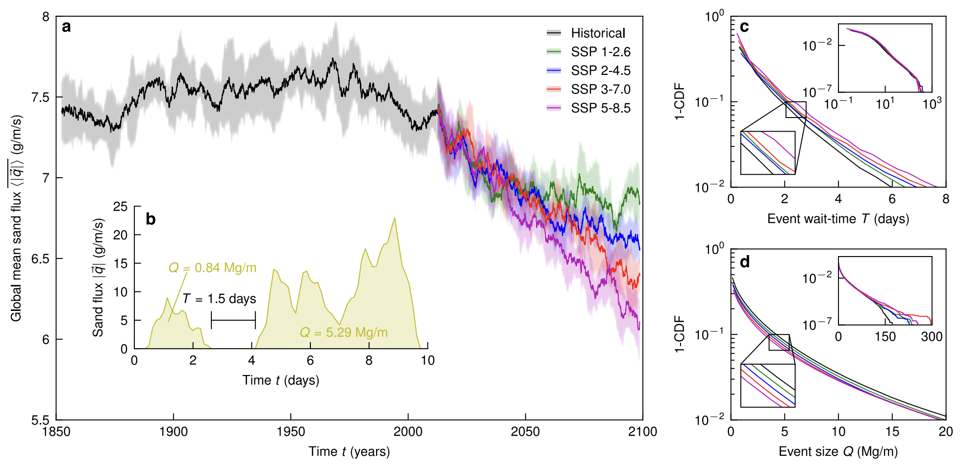
Results: Sand-sea activity predicted to decrease
Cannot be mitigated
Manifest through:
Longer periods of inactivity
Smaller transport events

